Slide 1
Let’s Get Started!
Welcome to 2018 SQL Saturday in San Diego
Steve Rezhener

Slide 2
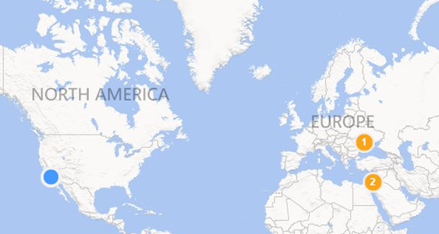
Background
Data Therapist, Husband, and Father of 2
13+ yrs. in a SQL Server field
MCITP SQL Server 2005/2008, MBA
SQL Malibu (join us remotely)
SQL Saturday in LA Organizer
LA SQL Boot Camp
CozyRoc-Star
MelissaData MVP
Email: steve.rezhener@hotmail.com
Twitter: @SteveRezhener
LinkedIn: https://www.linkedin.com/in/steverezhener/
2 |

Slide 3








Please Support Our Sponsors
SQL Saturday in San Diego is made possible with the generous support of these sponsors.
You can support them by opting-in and visiting them in the sponsor area.

Slide 4
Regional Local User Groups
SQL Malibu User Group 3rd Wednesday of each month sqlmalibu.pass.org Join us remotely! | L.A. User Group 3rd Thursday of each odd month sql.la
Los Angeles - Korean Every Other Tuesday sqlangeles.pass.org | San Diego User Group 1st & 3rd Thursday of each month meetup.com/sdsqlug meetup.com/sdsqlbig
Orange County User Group 2rd Thursday of each month bigpass.pass.org Orange County Power BI User Group meetup.com/OC-Power-BI-User-Group/ | Sacramento User Group 1st Wednesday of each month http://sac.pass.org/

Slide 5
Regional SQL Saturday events
2018 | 2019
San Diego (#802) When: September 22, 2018 Where: University of California San Diego Extension in San Diego | Orange County When: March-April 2019 Where: Golden West College in Huntington Beach Los Angeles When: June 2019 Where: Loyola Marymount University in Playa Vista Sacramento When: July 2019 Where: Sacramento San Diego When: September 2019 Where: San Diego Silicon Valley When: TBD Where: Mountain View

Slide 6
Introduction to SSIS and more
Love to hate it
OR
Hate to love it!
My SSIS Guru = Jamie Thompson
6 |

Slide 7
Agenda
ETL/ELT basics
ETL software
Introduction to SSIS
Create a simple SSIS package
Test-drive a Raw File feature
What’s new in SSIS 2016
Test-drive select new features
7 |

Slide 8
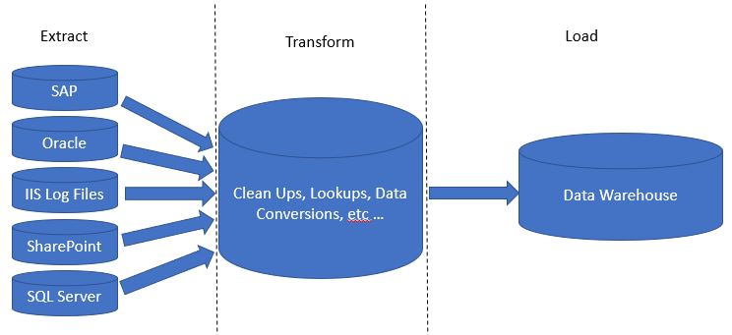
ETL Basics
Extract – get the data out
Load – load the data
Transform – change the data
8 |

Slide 9
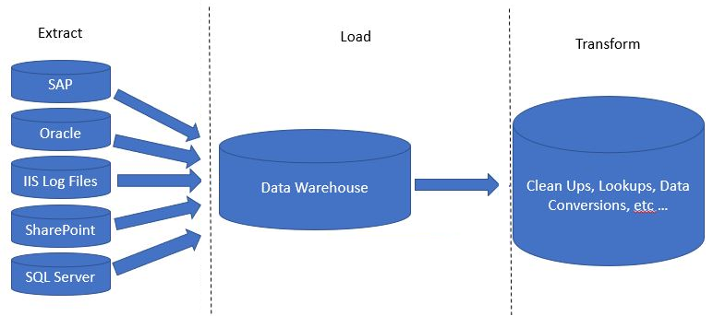
ELT Basics
Extract – get the data out
Transform – change the data
Load – load the data
9 |

Slide 10
Agenda (progress)
ETL/ELT basics
ETL software
Introduction to SSIS
Create a simple SSIS package
Test-drive a Raw File feature
What’s new in SSIS 2016
Test-drive select new features
10 |

Slide 11
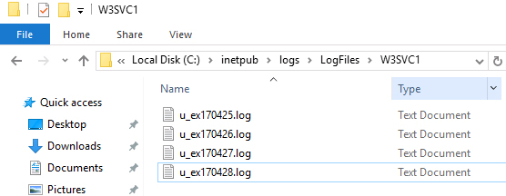
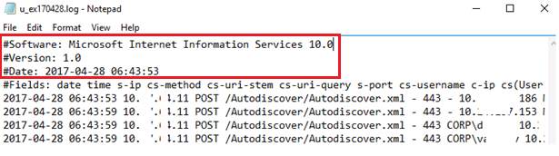

ETL software – The goal
Orchestrate moving data from A to B and/or transform with minimum coding
Example
YES
Clean?
IIS Logs
Database
NO

Slide 12
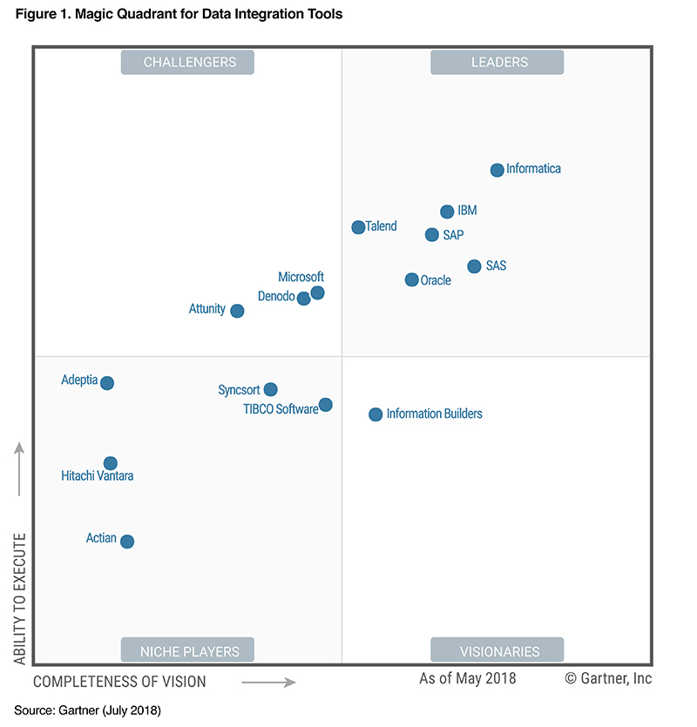
ETL software – the market
2018 Gartner quadrant
Microsoft headlines the market challengers in 2018. The world’s largest technology company had their standing improved considerably as a result of strong support for diverse data types, and synergy between data, applications, business roles and artificial intelligence. – Gartner
ETL software a.k.a. as Data Integration Tools

Slide 13
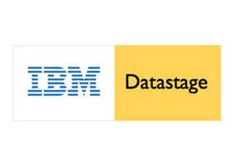












ETL software – the players

Slide 14
Agenda (progress)
ETL/ELT basics
ETL software landscape
Introduction to SSIS
Create a simple SSIS package
Test-drive a Raw File feature
What’s new in SSIS 2016/2017
Test-drive select new features
14 |

Slide 15
Introduction to SSIS
What is SSIS?
Advantages
Examples
Architecture
Essentials
SSIS vs. T-SQL & VB.NET/C#?
15 |

Slide 16
Introduction to SSIS - What is SSIS?
  Definition
  Microsoft Integration Services is a platform for building enterprise-level data integration and data transformations solutions.
  Integration Services can extract and transform data from a wide variety of sources such as XML data files, flat files, and relational data sources, and then load the data into one or more destinations. - https://docs.microsoft.com
16 |

Slide 17
Introduction to SSIS - advantages
Microsoft 3 biggest advantages:
No separate licensing needed = Included in one single SQL Server license
No steep learning curve = Visual Studio and .NET (No Java needed)
Tons of documentation = Huge Development Community support
17 |

Slide 18
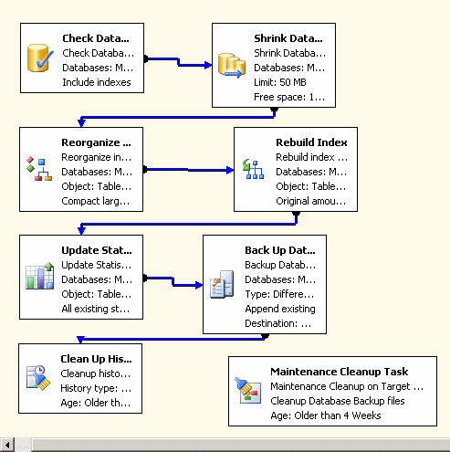
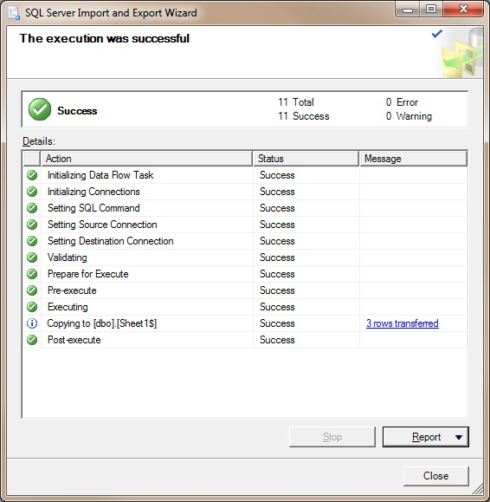
Introduction to SSIS - examples
Maintenance Plan Tasks and Export/Import Wizard
18 |

Slide 19
Introduction to SSIS (progress)
What is SSIS?
Advantages
Examples
Architecture
Essentials
SSIS vs. T-SQL & VB.NET/C#?
19 |

Slide 20
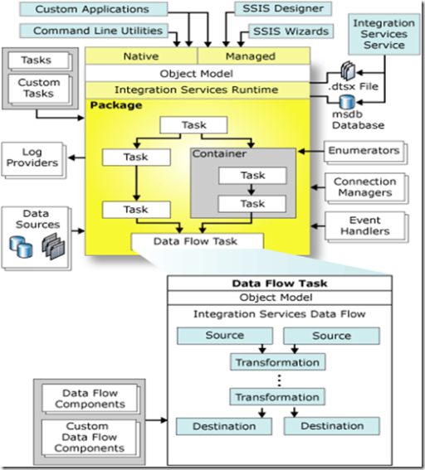



Introduction to SSIS - architecture
PreETL
&
PostETL
ETL
High-level internals:
DTEXEC.exe
DTSX file
Windows Service
SSISDB database
ETL
source
destination
20 |

Slide 21
Introduction to SSIS (progress)
What is SSIS?
Architecture
Essentials
SSIS vs. T-SQL & VB.NET/C#?
21 |

Slide 22

Introduction to SSIS – Essentials
  Tools (all FREE for Development purposes):
  SQL Server 2016/2017 Developer Edition
  Database Engine
  SQL Server Management Studio 2017
    Querying tool
  SQL Server Data Tools 2017 Community Edition
    SSIS Designer
  Works on Windows OS only!
22 |

Slide 23
Introduction to SSIS – Essentials (cont.)
Patience
SSIS Designer a.k.a. SSDT 2015/2017
As much more RAM as possible
Familiarity with:
  Connection string setup
  Design vs. run-time concepts
  Control Flow and Data Flow concepts
  T-SQL/ VB.NET or C#
  Error handling
  Experience with DTSX XML? ☺
23 |

Slide 24
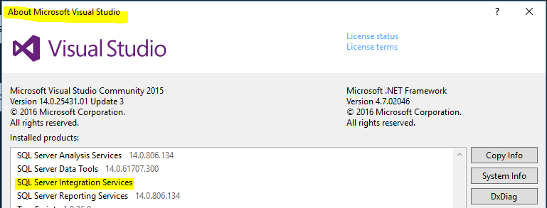
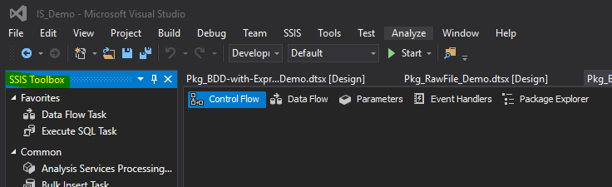
Introduction to SSIS – Essentials (cont.)
SSIS Template installed
SSIS Toolbox is available
-> Help
-> About Microsoft Visual Studio
Can’t find it?
1. Right-click anywhere
inside the package
2. Choose SSIS Toolbox
from the menu
24 |

Slide 25
Introduction to SSIS (progress)
What is SSIS?
Architecture
Essentials
SSIS vs. T-SQL & VB.NET/C#?
25 |

Slide 26
Introduction to SSIS - SSIS vs. T-SQL & VB.NET/C#?
SSIS is not a replacement for :
T-SQL
.NET
BULK INSERT and bcp
Main SSIS benefits:
  Process orchestration
  Isolated Windows Service
  Rapid development using drag-and-drop
  Flexibility to extend using VB.NET/C#
  Can run processes in parallel by design
26 |

Slide 27
Introduction to SSIS (progress)
What is SSIS?
Architecture
Essentials
SSIS vs. T-SQL & VB.NET/C#?
27 |

Slide 28
Agenda (progress)
ETL basics
ETL software landscape
Introduction to SSIS
Create a simple SSIS package
Test-drive Raw File feature
What’s new in SSIS 2016
Test-drive select new features
28 |

Slide 29
Create a simple SSIS package
Task: start an HVAC business in Los Angeles
Possible solution: Get a list of prospective clients to select from a database
29 |

Slide 30
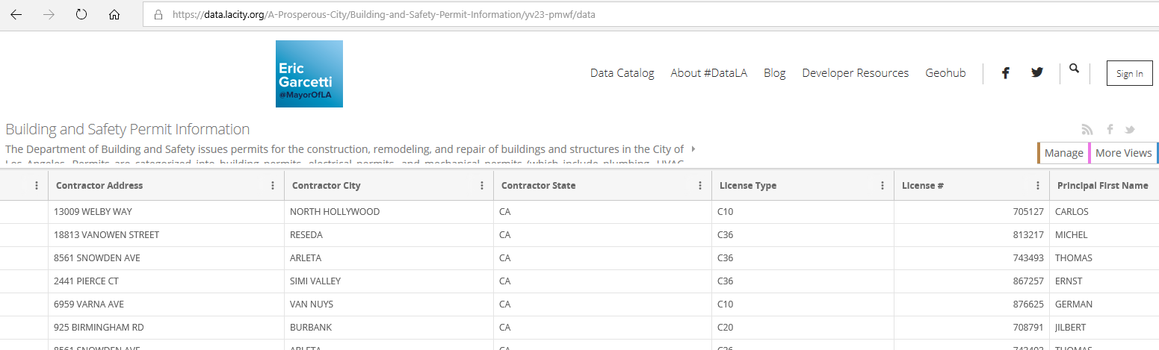
Create a simple SSIS package (continued)
Use case – load data into the database for fast querying
Source = LA Building and Safety Permit Information file on a local drive
255MB TSV file with 650K rows and 58 columns
downloaded from https://data.lacity.org/A-Prosperous-City/Building-and-Safety-Permit-Information/yv23-pmwf
Destination – Table on a local instance of SQL Server
30 |

Slide 31
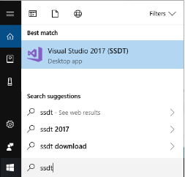
Create a simple SSIS package (continued)
  Type SSDT in Cortana (a.k.a. search box)
  Click on Visual Studio 2017 (SSDT)
31 |

Slide 32
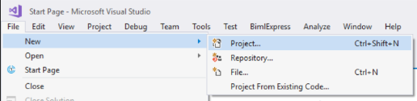
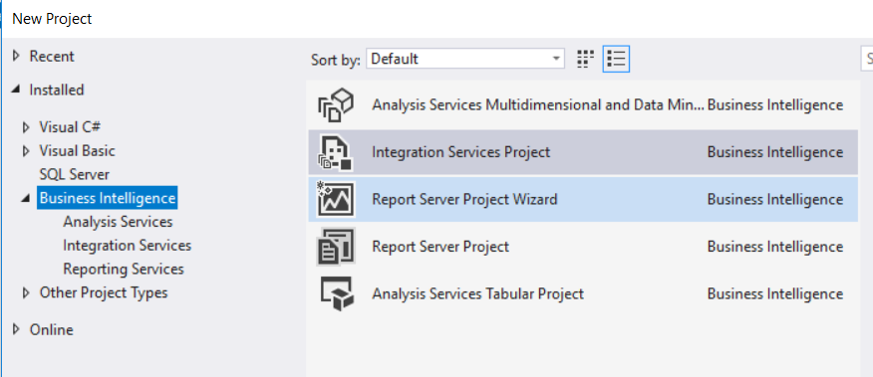
Create a simple SSIS package (continued)
File –> New –> Project
And Select Integration Services Project
32 |

Slide 33
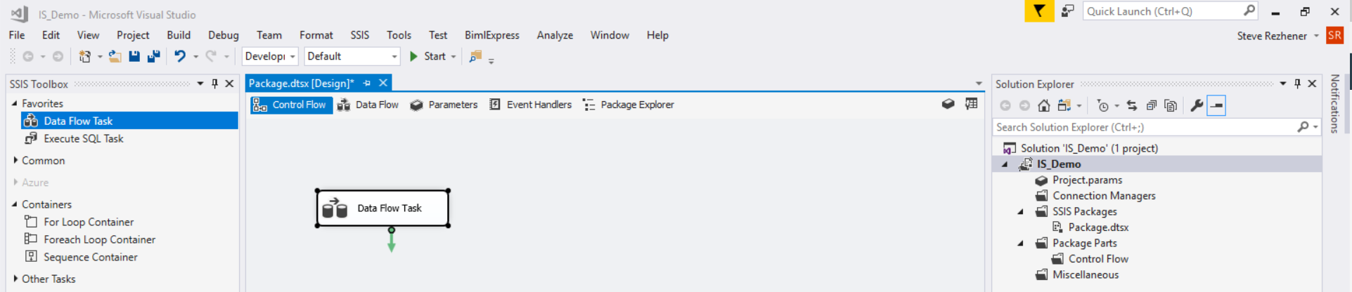
Create a simple SSIS package (continued)
33 |

Slide 34
Agenda (progress)
ETL basics
ETL software landscape
Introduction to SSIS
Create a simple SSIS package
Test-drive a Raw File feature
What’s new in SSIS 2016
Test-drive select new features
34 |

Slide 35
Test-drive a Raw File feature
Definition
Representation of the data is native to the source/destination, the data requires no translation and almost no parsing.
Pros: Read/write data more quickly than other sources/destination such as the Flat File and the OLE DB sources
Cons: Debugging could be tricky as it’s a binary file
35 |

Slide 36
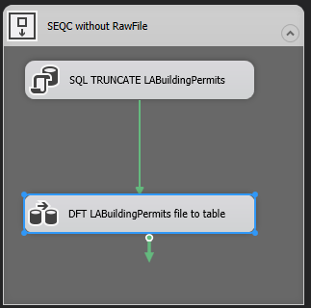
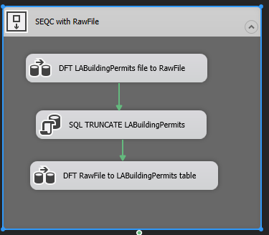
Test-drive a Raw File feature (continued)
Use case – keep table refreshed daily
Source = LA Building and Safety Permit Information file on a local drive
255MB TSV file with 650K rows and 58 columns
downloaded from https://data.lacity.org/A-Prosperous-City/Building-and-Safety-Permit-Information/yv23-pmwf
Destination – Table on a local instance of SQL Server
BEFORE
AFTER
source is slow and can’t be controlled
36 |

Slide 37
Test-drive a Raw File feature (continued)
  Introduce Raw File in 7 easy steps:
  Copy and paste a Data Flow task (add it above SQL TRUNCATE)
  Open the top Data Flow Task
  Drag and drop Raw File Destination
  Replace ADO .NET destination with Raw File Destination
  Open the bottom Data Flow Task
  Drag and drop Raw File Source
  Replace Flat File Source with Raw File Source
37 |

Slide 38

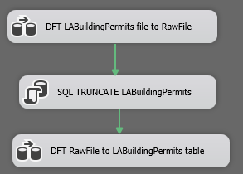
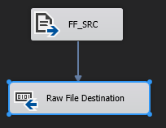
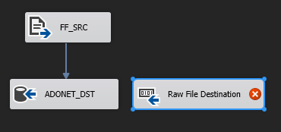
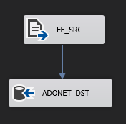

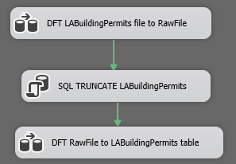
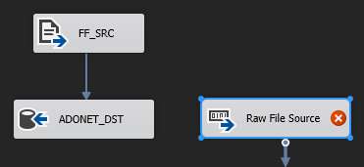
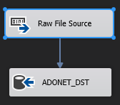
Test-drive a Raw File feature (continued)
38 |

Slide 39
Agenda (progress)
ETL basics
ETL software landscape
Introduction to SSIS
Create a simple SSIS package
Test-drive Raw File feature
What’s new in SSIS 2016
Test-drive select new features
39 |

Slide 40
What’s new in SSIS 2017?
Deprecated features
Still Missing Features
New Features
Test-drive select new features
40 |

Slide 41
What’s new in SSIS 2017 Deprecated features
No more VB Script
No more Execute DTS Task
Data Transformation Services (DTS) is deprecated.
41 |

Slide 42
What’s new in SSIS 2017 -
Still Missing Features
sFTP - CozyRoc
XML Source and Destination
PGP - CozyRoc
Support for Expressions in SQL Parameters
Encryption and masking
And many more …
Free: CodePlex
42 |

Slide 43
What’s new in SSIS 2017 -
New Features
Unification of SSDT and BIDS into VS 2015
Balanced Data Distributor (BDD)
Package parts
JSON and OData (Open Data Protocol)
BigData, Hadoop File System/Hive/Pig
Enhancements to MDS
SSIS Scale Out/Load Balancing (2017)
43 |

Slide 44
Agenda (progress)
Introduction to SSIS
Create a simple SSIS package
Test-drive Raw File feature
What’s new in SSIS 2016
Test-drive select new features
44 |

Slide 45
Test-drive select new features
Balanced Data Distributor (native to 2016)
Expression Task (available from 2012)
Package parts (available from 2016)
45 |

Slide 46
Test-drive select new features:
Balance Data Distributor
  Definition
  Microsoft® SSIS Balanced Data Distributor (BDD) is a new SSIS transform. This transform takes a single input and distributes the incoming rows to one or more outputs uniformly via multithreading.
  Pros: Performance boost due to multi-core/processor availability
  Cons: Limited to tables, makes the data unsorted, limited to number of cores
46 |

Slide 47
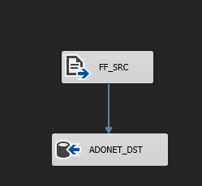
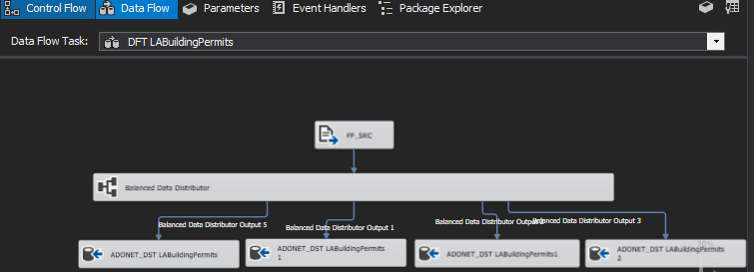
Test-drive select new features:
Balanced Data Distributor (continued)
Use case = load data quickly from a file into a table
Source = LA Building and Safety Permit Information file on a local drive
255MB TSV file with 650K rows and 58 columns downloaded
from https://data.lacity.org/A-Prosperous-City/Building-and-Safety-Permit-Information/yv23-pmwf
Destination – Table on a local instance of SQL Server
BEFORE
AFTER
47 |

Slide 48
Test-drive select new features:
Balanced Data Distributor (continued)
  Add BDD to an existing Data Flow process in 5 easy steps:
  Drag and Drop (into a Data Flow)
  Disconnect source and destination
  Reconnect through the BDD/Balancer
  Add more destinations
  Connect BDD outputs to Destinations
48 |

Slide 49

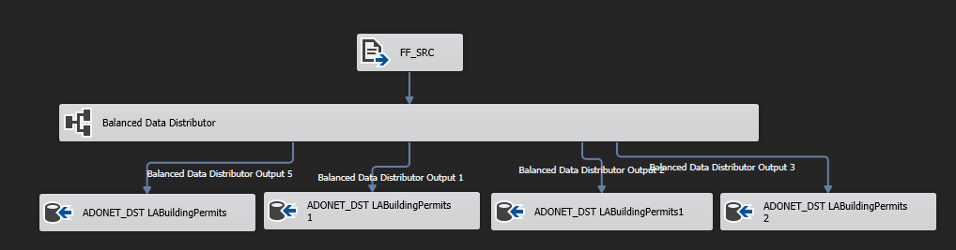
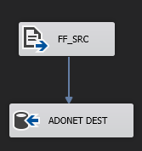
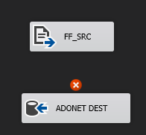
Test-drive select new features:
Balanced Data Distributor (continued)
49 |

Slide 50
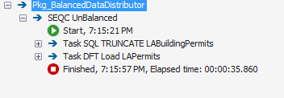
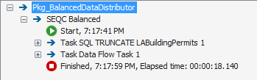
Test-drive select new features:
Balanced Data Distributor (continued)
Performance boost (x2)
Not using the BDD component
Using the BDD component
50 |

Slide 51
Test-drive select new features (progress)
Balanced Data Distributor (native to 2016)
Expression Task (available from 2012)
Package parts (available from 2016)
51 |

Slide 52
Test-drive select new features:
Expression Task
  Definition
  The Expression Task creates and evaluates expressions that set variable values at runtime, using the Expression Builder. When you edit the task, the Expression Builder is launched.
  Pros: Removes the need to use Script Task for SSIS expressions, enables variable reuse at runtime, promotes greater visibility
  Cons: None so far
52 |

Slide 53
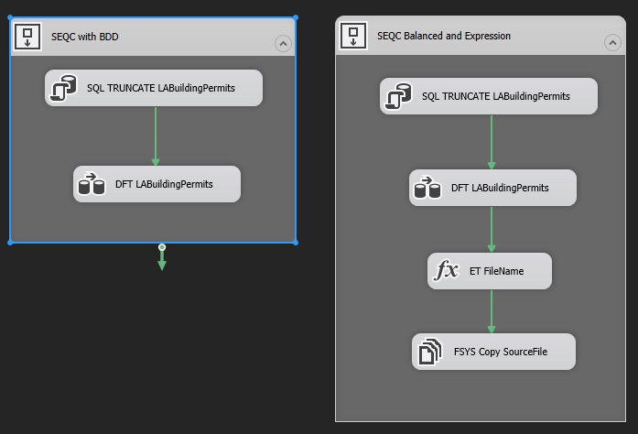
Test-drive select new features:
Expression Task (continued)
  Use case = manipulate filename value
BEFORE
AFTER
53 |

Slide 54
Test-drive select new features:
Expression Task (continued)
Introduce an Expression Task in 3 easy steps:
Disconnect the flow
Drag and Drop
Define Expression
Connect to control Flow

Slide 55

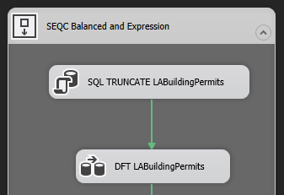
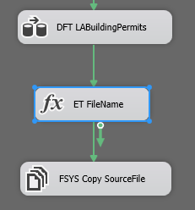

Test-drive select new features:
Expression Task (continued)

Slide 56
Test-drive select new features (progress)
Balanced Data Distributor (native to 2016)
Expression Task (available from 2012)
Package parts (available from 2016)
56 |

Slide 57
Test-drive select new features:
Package parts
  Definition
  Save a commonly used control flow task or container to a standalone part file - a “.dtsxp” file.
  Best use case scenario – logging/monitoring
  Pros: Reusability, single place to encapsulate frequently used logic
  Cons: Single point of failure, no support for nesting
57 |

Slide 58
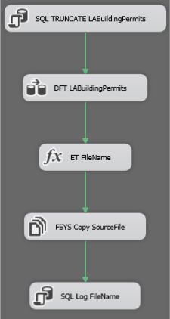
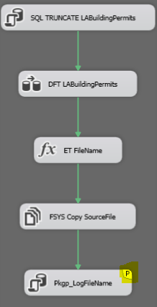
Test-drive select new features:
Package parts (continued)
Use case = implement reusable logging
BEFORE
AFTER

Slide 59
Test-drive select new features:
Package parts (continued)
Add a Package part in 5 easy steps:
Create a New Package Part
Add custom logic
Save as package part (dtsxp)
Select Package Parts from toolbox
Drag and drop to an existing package

Slide 60
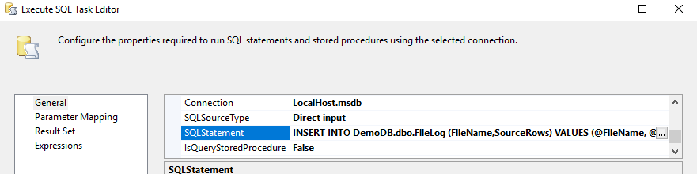
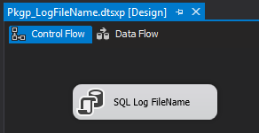

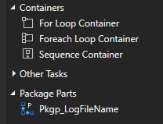
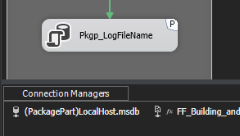
Test-drive select new features:
Package parts (continued)

Slide 61
Test-drive select new features (progress)
Balanced Data Distributor (native to 2016)
Expression Task (available from 2012)
Package parts (available from 2016)
61 |

Slide 62
Agenda (progress)
Introduction to SSIS
Create a simple ETL package
Test-drive select features – Raw File
What’s new in SSIS 2016
Test-drive select new features
62 |

Slide 63
Summary
At the end of this session, you should have learned:
ETL/ELT Basics
Familiarity with SSIS
How to create a basic SSIS package
How to use a Raw File component
What’s new in SSIS 2017
How to use BDD, Expression Task, Package Parts
63 |

Slide 64
Online Resources
Just Bing/Google it!

Slide 65




Questions?
steve.rezhener@hotmail.com
@SteveRezhener
https://www.linkedin.com/in/steverezhener
https://speakerrate.com/speakers/178591
Thank you!
65 |

