Slide 1
Let’s Get Started!
Steve Rezhener
Certified Human ®

Slide 2
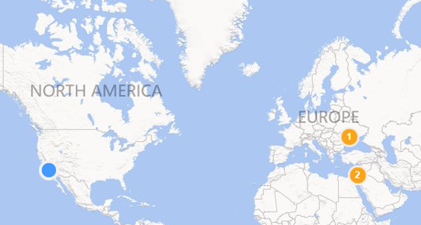
Introduction
Geek, Husband, and Father of 2
10+ yrs. in a SQL Server field
MCITP SQL Server 2005/2008, MBA
SQL Malibu Group Leader
SQL Saturday in LA Organizer
Email: steve.rezhener@hotmail.com
Twitter: @SteveRezhener
LinkedIn: https://www.linkedin.com/in/steverezhener/
2 |
Notes:
Born in Ukraine, moved to Israel and ended up in United States of America. I speak fluently in 2 foreign languages and this is my English is that bad! Can you guess if my original name is Steve?
I’m a novice speaker and need help. Need help from one person, to alert on questions, use of abbreviations.

Slide 3
Session
Organizing a
SQL Community Events
3 |
Notes:
Why running SQL community events? What does it take to run SQL community events? Lessons learned from SQL Malibu and SQL Saturday in LA.

Slide 4
Agenda
Benefits of organizing a SQL community event
What is a Local SQL Server User Group
  Learn from SQL Malibu Local User Group
What is a SQL Saturday event
  Learn from SQL Saturday in LA
Summary
4 |

Slide 5
Benefits of organizing a SQL Community event
Why organize?
Acquire new skills
Personal branding/visibility
Tons of fun
5 |

Slide 6
Benefits of organizing a SQL community event
Acquire new skills:
  Soft skills
  Delegation
  Communication
  Time management
  Experience in event management and crisis resolution
6 |

Slide 7
Benefits of organizing a SQL community event
Personal branding:
  Management material ready
  Consulting career
  Visibility
7 |

Slide 8
Benefits of organizing a SQL community event
Tons of fun:
Satisfaction
Excitement
8 |

Slide 9

Local SQL Server User Group
What is a Local SQL Server User Group?
Local Groups (formerly "Local Chapters") are a free and easily accessible resource for sharing knowledge, and connecting with other data professionals in your geographical area.
9 |

Slide 10
Local SQL Server User Group (cont.)
It’s a local meetup for SQL Server professionals
A place to network
A chance to ask a questions and get answers instantly (+credibility factor)
An opportunity to learn
5-20 attendees
10 |

Slide 11
Local SQL Server User Group (cont.)
Challenges:
Team
Venue (required for a physical event)
Fixed schedule/frequency
Attendees (competing on a precious time*)
Speakers
Sponsors
Budget
Communication
* Tough competition with Google/YouTube/Lynda/PluralSight
11 |

Slide 12

SQL Malibu User Group
Lessons learned from SQL Malibu User Group
Built a strong Team of 5+
Secured Microsoft Store as a venue
Locked every 3rd Wednesday of every month
Won-over attendees using Twitter and LinkedIn
Acquired great speakers using Twitter
Solicited sponsors for swag/funds
Spent less, collected more (budget/finances)
Lead communication via MailChimp/Twitter/LinkedIn
12 |

Slide 13
SQL Malibu User Group (cont.)
FREE tools to run the user group
Administration:
  Eventbrite (sqlmalibu.eventbrite.com)
  Web site (sqlmalibu.pass.org)
  PayPal (paypal.me/sqlmalibu)
  Zoom (courtesy of HushHush)
  SurveyMonkey
Marketing:
  MailChimp (2+ monthly email campaigns)
  Twitter/tweetdeck.twitter.com (@sqlmalibu)
  LinkedIn/HooteSuite.com
  Facebook Page (facebook.com/sqlmalibu)
13 |

Slide 14

SQL Saturday
What is a SQL Saturday?
PASS SQLSaturdays are free 1-day training events for SQL Server professionals that focus on local speakers, providing a variety of high-quality technical sessions, and making it all happen through the efforts of volunteers. Whether you're attending a SQLSaturday or thinking about hosting your own, we think you'll find it's a great way to spend a Saturday – or any day.
14 |

Slide 15
SQL Saturday (cont.)
It’s a local event for SQL Server professionals
A place to network
A chance to ask questions and get answers instantly
An opportunity to learn
An annual event
Gathers 100-500 attendees
15 |

Slide 16
SQL Saturday (cont.)
Challenges:
Event day
Team
Venue
Schedule/Speakers/Sessions
Attendees
Sponsors
Budget
Communication
16 |

Slide 17
SQL Saturday in LA
Lessons learned from SQL Saturday in LA:
Locked Saturday, June 10, 2017
Built a strong team of 25+
Secured a venue (MTC/VDMS)
Solicited 7 tracks/44 speakers/50 sessions
Solicited 300+ attendees
Solicited 28 sponsors
Defined an operating budget
Communicated via MailChimp/Twitter/LinkedIn
17 |

Slide 18
SQL Saturday in LA (cont.)
FREE tools to run the event
Administration:
  Eventbrite (speaker dinner + after-party)
  Web site (sqlsaturday.com/640)
  PayPal
  SurveyMonkey (lunch preferences)
Marketing:
  MailChimp (10+ email marketing campaigns)
  Twitter/tweetdeck.twitter.com @SQLSatLA
  LinkedIn/HooteSuite.com
  Facebook (facebook.com/sqlsatla)
  YouTube + VDMS Uplynk session recording
18 |

Slide 19
Summary
At the end of this session, you should have learned:
Benefits of running a SQL Server event
How to organize a local SQL Server User group
  Lessons from SQL Malibu User Group
How to organize SQL Saturday event
  Lessons from SQL Saturday in LA
It doesn’t take a rocket science degree to organize a SQL event!
19 |

Slide 20




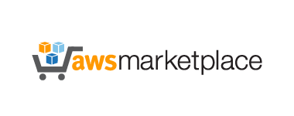
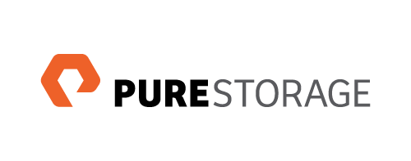
























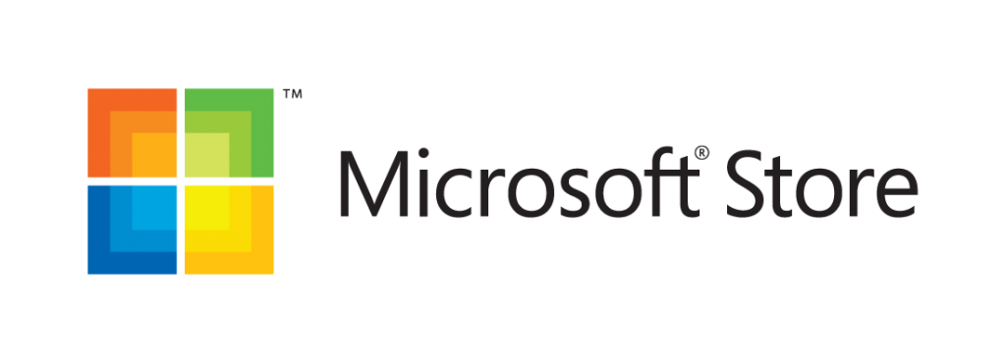


Please Support Our Sponsors
SQL Saturday in Los Angeles is made possible with the generous support of these sponsors.
You can support them by opting-in and visiting them in the sponsor area.

Slide 21



Questions?
steve.rezhener@hotmail.com
@SteveRezhener
https://www.linkedin.com/in/steverezhener
Thank you!
21 |

Slide 22
South West Region Local User Groups
L.A. User Group 3rd Thursday of each odd month sql.la | SQL Malibu User Group 3rd Wednesday of each month sqlmalibu.pass.org
Los Angeles - Korean Every Other Tuesday sqlangeles.pass.org | San Diego User Group 1st & 3rd Thursday of each month meetup.com/sdsqlug meetup.com/sdsqlbig
Orange County User Group 2rd Thursday of each month bigpass.pass.org | Sacramento User Group 1st Wednesday of each month http://sac.pass.org/

Slide 23
Upcoming SQL Saturdays in California
SQL Saturday in Sacramento 2017 (#650)
When: Saturday, July 15, 2017
http://sqlsaturday.com/650/eventhome.aspx
SQL Saturday in San Diego 2017 (#661)
When: Saturday, September 23, 2017
http://sqlsaturday.com/661/eventhome.aspx

