Slide 1
Let’s Get Started!
Welcome to SQL Saturday in San Diego
Steve Rezhener

Slide 2
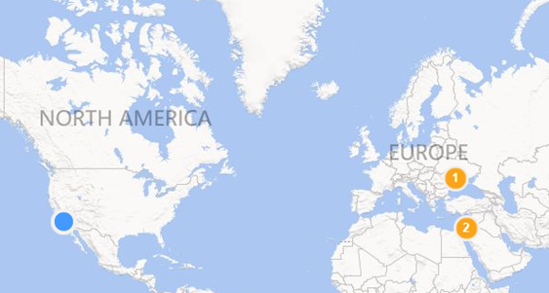
Background
Geek, Husband, and Father of 2
10+ yrs. in a SQL Server field
MCITP SQL Server 2005/2008, MBA
SQL Malibu Group Leader
SQL Saturday in LA Organizer
Email: steve.rezhener@hotmail.com
Twitter: @SteveRezhener
LinkedIn: https://www.linkedin.com/in/steverezhener/
2 |

Slide 3










Please Support Our Sponsors
SQL Saturday in Los Angeles is made possible with the generous support of these sponsors.
You can support them by opting-in and visiting them in the sponsor area.

Slide 4
Southwest Region Local User Groups
SQL Malibu User Group 3rd Wednesday of each month sqlmalibu.pass.org | L.A. User Group 3rd Thursday of each odd month sql.la
Los Angeles - Korean Every Other Tuesday sqlangeles.pass.org | San Diego User Group 1st & 3rd Thursday of each month meetup.com/sdsqlug meetup.com/sdsqlbig
Orange County User Group 2rd Thursday of each month bigpass.pass.org | Sacramento User Group 1st Wednesday of each month http://sac.pass.org/

Slide 5
Introduction to SSRS and more
Love to hate it
OR
Hate to love it!
5 |

Slide 6
Agenda
Reporting basics
Reporting software landscape
Introduction to SSRS
Create a simple SSRS report
What’s new in SSRS 2016
Test-drive SSRS on SSRS
“Code-transparency” technique
6 |

Slide 7
Reporting basics
  Gives the ability to non-technical people to see the data*
  Capable to grab data from different sources*
  Reporting is based on a SQL language*
  Reporting directly on operational data is a BAD idea*
  *Usually
  Sometimes referred as Data Visualization Tools
7 |

Slide 8
Agenda (progress)
Reporting basics
Reporting software landscape
Introduction to SSRS
Create a simple SSRS report
What’s new in SSRS 2016
Test-drive SSRS on SSRS
“Code-transparency” technique
8 |

Slide 9









Reporting software landscape
The 2017 Magic Quadrant -
Tableau and Microsoft are taking an important lead in the Business Intelligence Industry.
9 |

Slide 10
Agenda (progress)
Reporting basics
Reporting software landscape
Introduction to SSRS
Create a simple SSRS report
What’s new in SSRS 2016
Test-drive SSRS on SSRS
“Code-transparency” technique
10 |

Slide 11
Introduction to SSRS
What is SSRS?
Architecture
Essentials
Main Benefits
SSRS vs. T-SQL & VB.NET
11 |

Slide 12
Introduction to SSRS - What is SSRS?
  Definition
  SQL Server Reporting Services is a solution that customers deploy on their own premises for creating, publishing, and managing reports, then delivering them to the right users in different ways, whether that’s viewing them in web browser, on their mobile device, or as an email in their in-box.
  - https://docs.microsoft.com
12 |

Slide 13
Introduction to SSRS (progress)
What is SSRS?
Architecture
Essentials
Main Benefits
SSRS vs. T-SQL & VB.NET
13 |

Slide 14
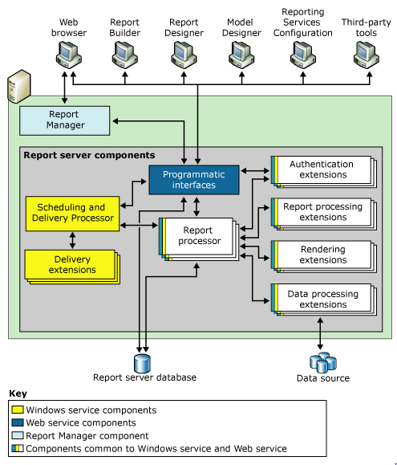
Introduction to SSRS - architecture
Consume
Create
High-level internals:
Separate IIS server
Report Portal web site
Windows and Web Service
ReportServer database
3 main tables:
Catalog – RDL files
Users – users
ExecutionLogStorage – report execution log
ReportServerTempDB database
14 |

Slide 15
Introduction to SSRS (progress)
What is SSRS?
Architecture
Essentials
Main Benefits
SSRS vs. T-SQL & VB.NET
15 |

Slide 16
Introduction to SSRS - Essentials
Patience
SSRS Designer a.k.a. SSDT 2015
Familiarity with:
  DataSource and DataSet
  Design vs. run-time concepts
  T-SQL and VB.NET
  Experience with RDL XML?
16 |

Slide 17
Introduction to SSRS (progress)
What is SSRS?
Architecture
Essentials
Main Benefits
SSRS vs. T-SQL & VB.NET
17 |

Slide 18
Introduction to SSRS
Main benefits
  Included with typical SQL Server licensing
  SSRS Windows Service
  Report Portal web site
  Built-in scalability and caching
  Scheduled Subscription engine (email and fileshare)
  Rapid development using drag-and-drop components
  Flexibility to extend using VB.NET
  Web site integration with ReportViewer control

Slide 19
Introduction to SSRS
Main benefits (continued)
End-user usability features:
  Pagination support
  Export to PDF, Excel, CSV, Word (PPT from 2016)
  Print-friendly
  Search-box
  Mobile support (HTML 5.0 support in SSRS 2016)

Slide 20
Introduction to SSRS (progress)
What is SSRS?
Architecture
Essentials
Main Benefits
SSRS vs. T-SQL & VB.NET
20 |

Slide 21
Introduction to SSRS
SSRS vs. T-SQL & VB.NET
SSRS is not a replacement for T-SQL
SSRS is not a replacement for .NET
SSRS is replacing a custom .NET code that does reporting!
21 |

Slide 22
Introduction to SSRS (progress)
What is SSRS?
Architecture
Essentials
Main Benefits
SSRS vs. T-SQL & VB.NET
22 |

Slide 23
Agenda (progress)
Introduction to SSRS
Create a simple SSRS report
What’s new in SSRS 2016
Test-drive SSRS on SSRS
“Code-transparency” technique
23 |

Slide 24
Create a simple SSRS report
Task: monitor recovery models of all databases
Possible solution: display all the databases in a report
24 |

Slide 25
Create a simple SSRS package (continued)
Create in 6 easy steps
  Write a stored procedure using SSMS
  Create a new SSRS report using SSDT
  Create a data source
  Create a dataset (using existing stored proc)
  Auto-populate with the Wizard
  Deploy the report
Access/consume the report via Report Portal interface
25 |

Slide 26
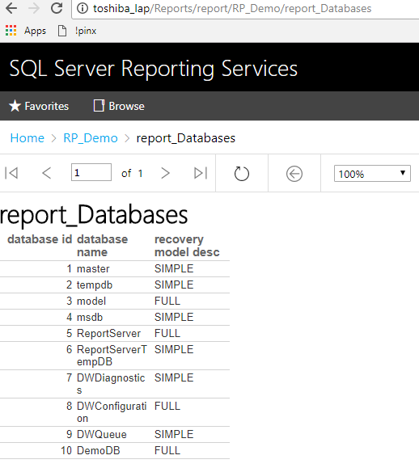
Create a simple SSRS package (continued)
Use case = displaying recovery models of all databases
Source = Query a master database on local instance of SQL Server
Destination = SSRS report on ReportPortal
26 |

Slide 27
Agenda (progress)
Introduction to SSRS
Create a simple SSRS report
What’s new in SSRS 2016
Test-drive SSRS on SSRS
“Code-transparency” technique
27 |

Slide 28
What’s new in SSRS 2016?
Deprecated features
Still Missing Features
New Features
Test-drive select new features
28 |

Slide 29
What’s new in SSRS 2016
Deprecated features
HTML4.0 renderer
29 |

Slide 30
What’s new in SSRS 2016
Still Missing features
C#
Scheduling delivery via printer
30 |

Slide 31
What’s new in SSRS 2016
New features
Key performance indicators (KPI)
Mobile support with HTML 5.0
Report Manager face lift to Report Portal
Export to PowerPoint
Enable and disable subscriptions
Custom Parameters Pane
31 |

Slide 32
Agenda (progress)
Introduction to SSRS
Create a simple SSRS report
What’s new in SSRS 2016
Test-drive SSRS on SSRS
“Code-transparency” technique
32 |

Slide 33
Test-drive SSRS on SSRS
Definition
SSRS reports on SSRS reports
33 |

Slide 34
Test-drive SSRS on SSRS
Reports inventory
Report usage
Subscription information
34 |

Slide 35
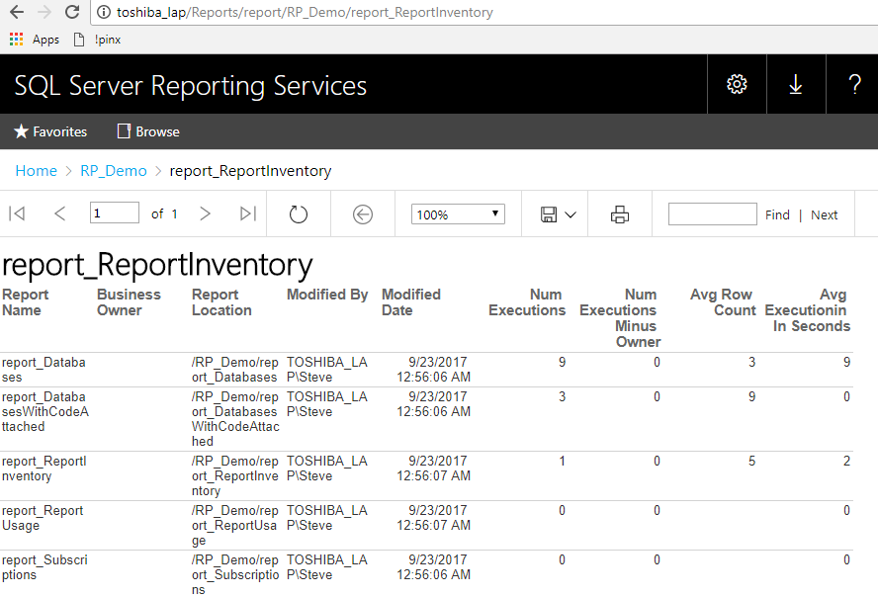

Test-drive SSRS on SSRS
Reports inventory
35 |

Slide 36
Test-drive SSRS on SSRS (progress)
Reports inventory
Report usage
Subscription information
36 |

Slide 37
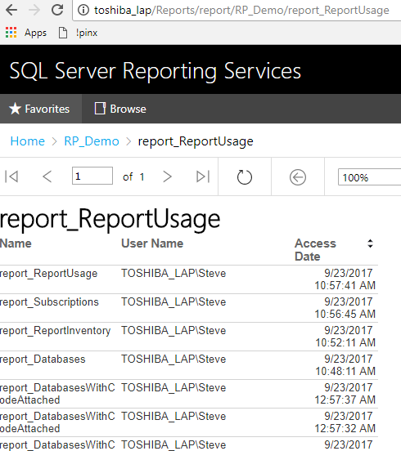

Test-drive SSRS on SSRS
Report usage
37 |

Slide 38
Test-drive SSRS on SSRS (continued)
Reports inventory
Report usage
Subscription information
38 |

Slide 39
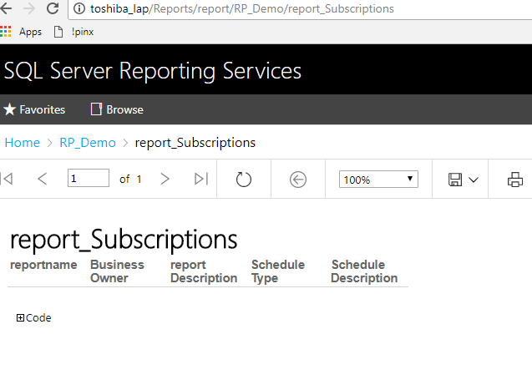

Test-drive SSRS on SSRS
Subscription information
39 |

Slide 40
Test-drive SSRS on SSRS (progress)
Reports inventory
Report usage
Subscription information
40 |

Slide 41
Agenda (progress)
Introduction to SSRS
Create a simple SSRS report
What’s new in SSRS 2016
Test-drive SSRS on SSRS
“Code-transparency” technique
41 |

Slide 42
“Code-transparency” technique
Definition
Making the code visible inside the report, attaching the code to the results
42 |

Slide 43
“Code-transparency” technique (continued)
Create in 4 easy steps:
  Select report
  Create an additional dataset
  Use sp_helptext with report’s stored procedure
  Add a toggle control
43 |

Slide 44
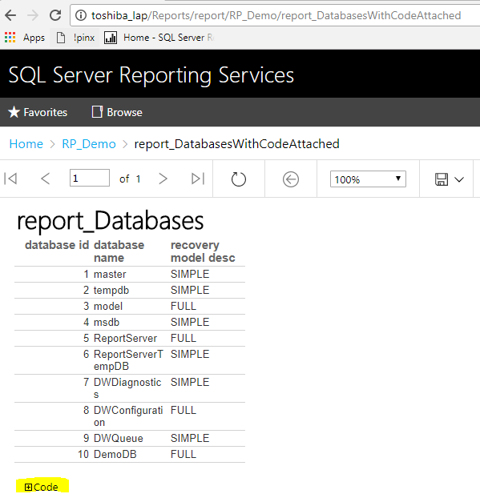
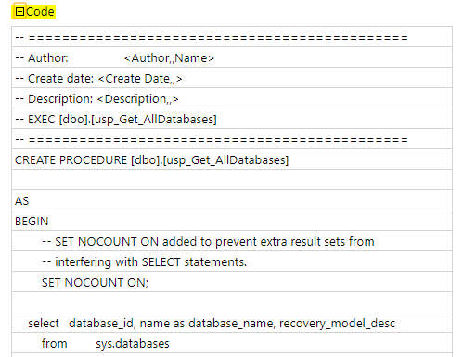
“Code-transparency” technique (continued)
44 |

Slide 45
Agenda (progress)
Introduction to SSRS
Create a simple SSRS report
What’s new in SSRS 2016
Test-drive SSRS on SSRS
“Code-transparency” technique
45 |

Slide 46
Summary
At the end of this session, you should have learned:
Familiarity with SSRS
How to create a basic SSRS report
What’s new in SSRS 2016
SSRS Reports on SSRS Reports
46 |

Slide 47



Questions?
steve.rezhener@hotmail.com
@SteveRezhener
https://www.linkedin.com/in/steverezhener
Thank you!
47 |

