Slide 1
Let’s Get Started!
Welcome to 2019 SQL Saturday in San Diego (#909)
Steve Rezhener

Slide 2
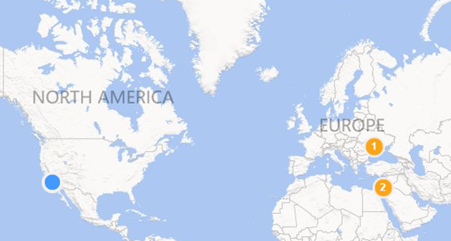
Background
Consultant at SQL Solutions Group
Data Therapist, Husband, and Father of 2
LA Data Platform (a.k.a. SQL Malibu)
SQL Saturday in Los Angeles
COZYROC-Star
Melissa MVP
2 |

Slide 3











Please Support Our Sponsors
SQL Saturday in Orange County is made possible with the generous support of these sponsors.
You can support them by opting-in and visiting them in the sponsor area.

Slide 4
Regional Local User Groups
LA Data Platform (a.k.a. SQL Malibu) 3rd Wednesday of each month ladataplatform.pass.org - Join us remotely! | L.A. User Group 3rd Thursday of each odd month sqlla.pass.org
Los Angeles - Korean Every Other Tuesday sqlangeles.pass.org | San Diego User Group 1st & 3rd Thursday of each month meetup.com/sdsqlug meetup.com/sdsqlbig
Orange County User Group 2rd Thursday of each month bigpass.pass.org Orange County Power BI User Group meetup.com/OC-Power-BI-User-Group/ | Sacramento User Group 1st Wednesday of each month http://sac.pass.org/

Slide 5
California 2019 SQL Saturday events
Orange County When: April TBD, 2020 Where: TBD | Los Angeles When: June TBD, 2020 Where: TBD
San Diego When: September TBD, 2020 Where: TBD | Sacramento When: August TBD, 2020 Where: TBD
 | Silicon Valley When: TBD Where: Mountain View

Slide 6
Introduction to SSIS and third-party components
  OR how to use SSIS to market a Shady Insurance Practice! ;)
6 |

Slide 7
Agenda
Introduction to ETL
Introduction to SSIS
Create a simple SSIS package
What’s new in SSIS 2017
SSIS Third-party components
Test-drive Melissa and COZYROC
7 |

Slide 8
Introduction to ETL
Basics
Example
ETL/ELT
Landscape
8 |

Slide 9


Introduction to ETL – Basics
Extract
Get the data out
Transform
Modify/Change the data
Load
Load the data in

Slide 10
ETL
Basics
Example
ETL/ELT
Landscape
10 |

Slide 11
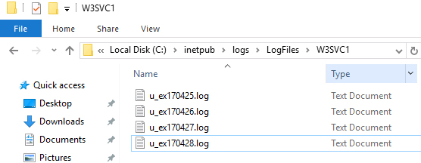
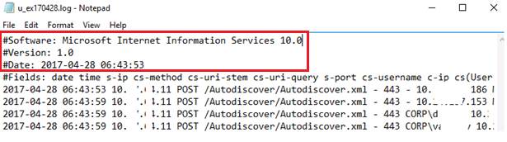

ETL – Example
Orchestrate moving data from A to B and/or transform with minimum coding
Example: Move IIS log files to a database
YES
Clean?
IIS Logs
Database
NO

Slide 12

Introduction to ETL
Basics
Example
ETL/ELT
Landscape
12 |

Slide 13
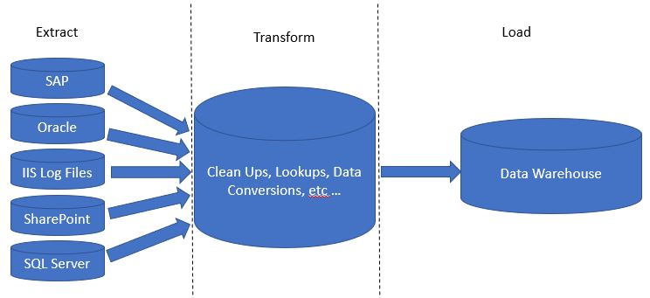
Introduction to ETL – ETL vs. ELT
Extract
Transformation
Load
SAP ERP
Oracle Financials
Cleanup, Lookup, Conversion
Data Warehouse
Windows Server IIS Log Files
Microsoft SharePoint
AWS S3 Bucket
Extract – get the data out | Transform – change the data | Load – load the data
13 |

Slide 14
Introduction to ELT - ETL vs. ELT (cont.)
Extract
Load
Transformation
SAP ERP
Oracle Financials
Staging
Cleanup, Lookup, Conversion
Data Warehouse
Windows Server IIS Log Files
Microsoft SharePoint
AWS S3 Bucket
Extract – get the data out | Load – load the data | Transform – change the data
14 |

Slide 15
Introduction to ETL
Basics
Example
ETL/ELT
Software Landscape
15 |

Slide 16
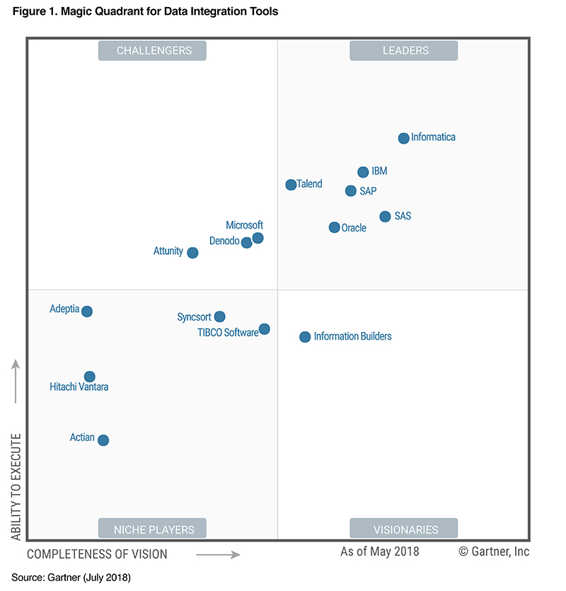
Introduction to ETL – Software landscape
2018 Gartner quadrant
Microsoft headlines the market challengers in 2018. The world’s largest technology company had their standing improved considerably as a result of strong support for diverse data types, and synergy between data, applications, business roles and artificial intelligence. – Gartner
ETL software a.k.a. as Data Integration Tools

Slide 17
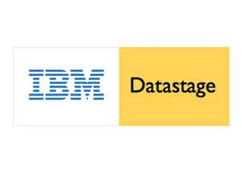
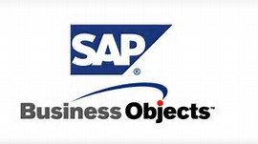







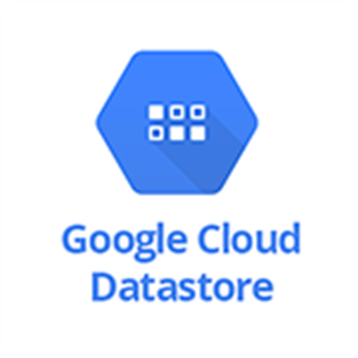



Introduction to ETL – Software landscape (cont.)

Slide 18
Introduction to ETL
Basics
Example
ETL/ELT
Software Landscape
18 |

Slide 19
Agenda (progress)
Introduction to ETL
Introduction to SSIS
Create a simple SSIS package
What’s new in SSIS 2017
SSIS Third-party components
19 |

Slide 20
Introduction to SSIS
What is SSIS?
Advantages
Examples
Architecture
Essentials
SSIS vs. T-SQL & .NET?
20 |

Slide 21
Introduction to SSIS - What is SSIS?
  Definition
  Microsoft Integration Services is a platform for building enterprise-level data integration and data transformations solutions.
21 |

Slide 22
Introduction to SSIS - What is SSIS?
  Definition (cont.)
  Integration Services can extract and transform data from a wide variety of sources such as XML data files, flat files, and relational data sources, and then load the data into one or more destinations. - https://docs.microsoft.com
22 |

Slide 23
Introduction to SSIS (progress)
What is SSIS?
Advantages
Examples
Architecture
Essentials
SSIS vs. T-SQL & .NET?
23 |

Slide 24
Introduction to SSIS - advantages
Microsoft 3 biggest advantages:
No separate licensing needed = Included in one single SQL Server license
No steep learning curve = Visual Studio and .NET (No Java needed)
Tons of documentation = Huge Development Community support
24 |

Slide 25
Introduction to SSIS (progress)
What is SSIS?
Advantages
Examples
Architecture
Essentials
SSIS vs. T-SQL & .NET?
25 |

Slide 26
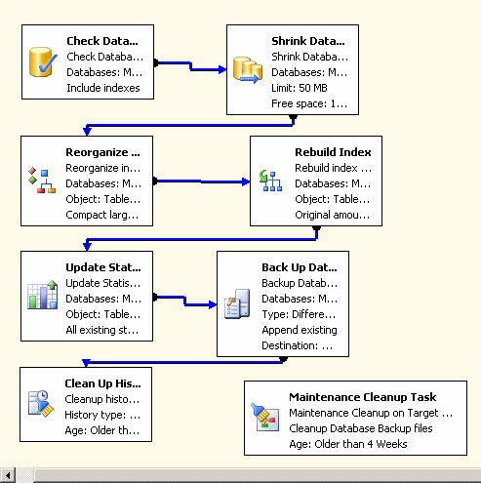
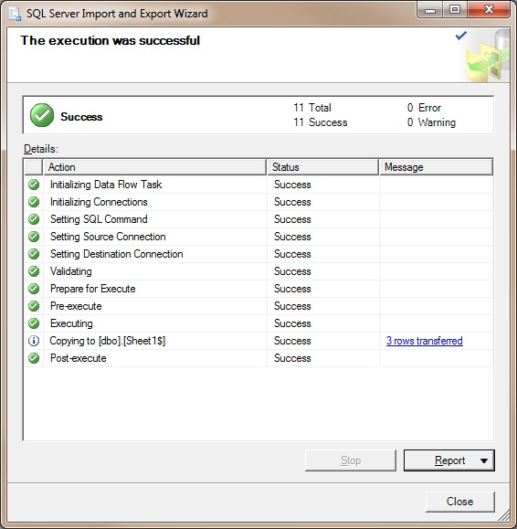
Introduction to SSIS - examples
Maintenance Plan Tasks and Export/Import Wizard
26 |

Slide 27
Introduction to SSIS (progress)
What is SSIS?
Advantages
Examples
Architecture
Essentials
SSIS vs. T-SQL & .NET?
27 |

Slide 28
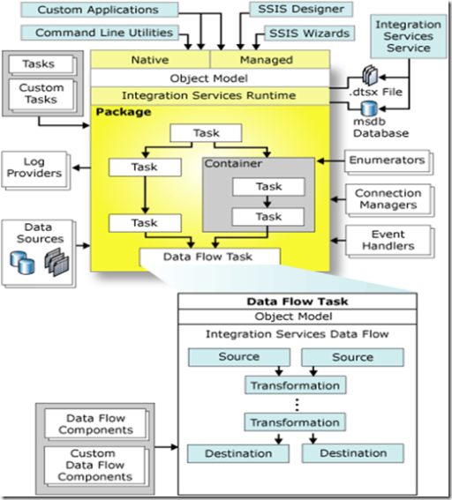



Introduction to SSIS - architecture
PreETL
ETL
PostETL
High-level internals:
DTEXEC.exe
DTSX file
Windows Service
SSISDB database
source
ETL
destination
28 |

Slide 29
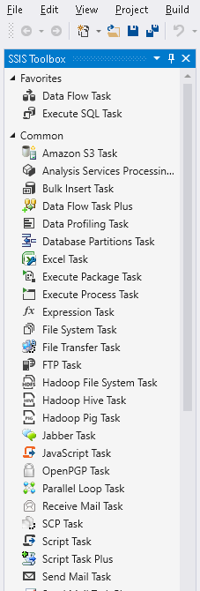
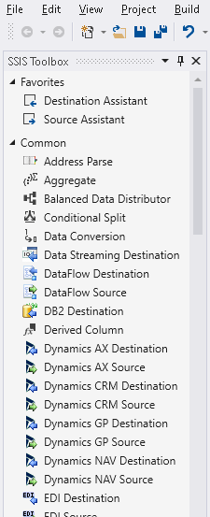
Introduction to SSIS – architecture (cont.)
Control Flow
Data Flow
source
PreETL
ETL
ETL
PostETL
destination
29 |

Slide 30
Introduction to SSIS (progress)
What is SSIS?
Advantages
Examples
Architecture
Tools
Concepts
SSIS vs. T-SQL & .NET?
30 |

Slide 31
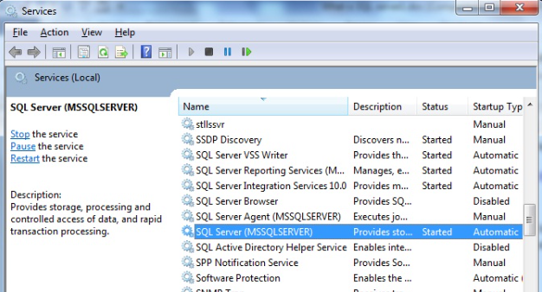

Introduction to SSIS – Tools
  Tools ($0 for Development purposes):
  Database Engine
  SQL Server 2016/2017 Developer Edition
Windows only!
https://www.microsoft.com/en-us/sql-server/sql-server-downloads
31 |

Slide 32
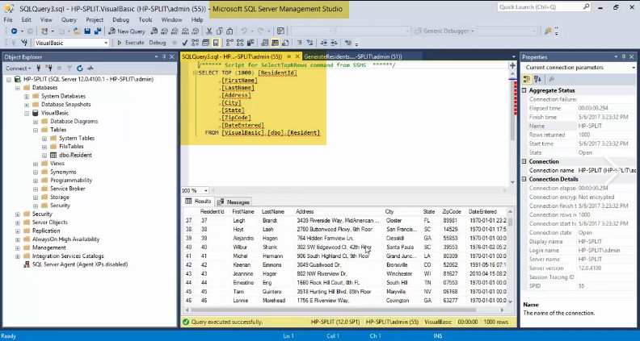
Introduction to SSIS – Tools (cont.)
  Tools ($0 for Development purposes):
  Querying tool
  SQL Server Management Studio 2017 (SSMS)
Windows only!
https://docs.microsoft.com/en-us/sql/ssms/download-sql-server-management-studio-ssms?view=sql-server-2017
32 |

Slide 33
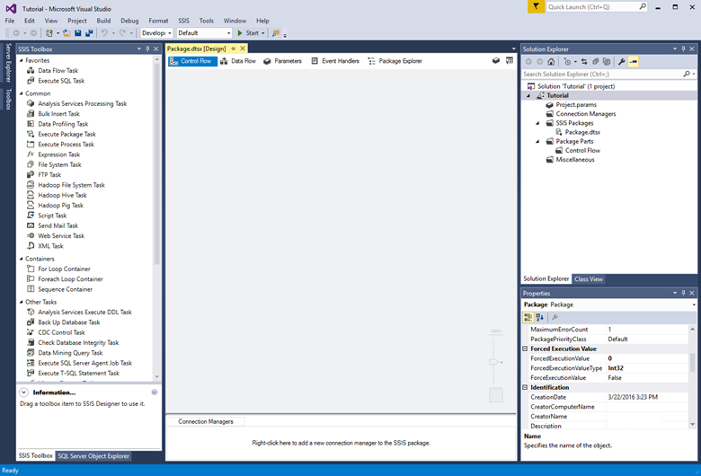
Introduction to SSIS – Tools (cont.)
  Tools ($0 for Development purposes):
  SSIS Designer
  SQL Server Data Tools 2017 Community Edition
Windows only!
https://docs.microsoft.com/en-us/sql/ssdt/download-sql-server-data-tools-ssdt?view=sql-server-2017
33 |

Slide 34
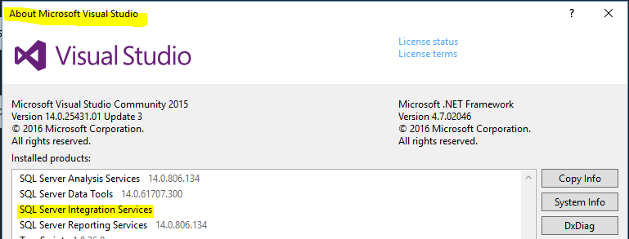
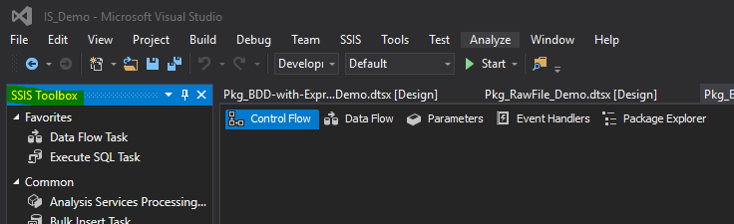
Introduction to SSIS – Tools (cont.)
SSIS Template installed
SSIS Toolbox is available
-> Help
-> About Microsoft Visual Studio
Can’t find it?
1. Right-click anywhere
inside the package
2. Choose SSIS Toolbox
from the menu
34 |

Slide 35
Introduction to SSIS (progress)
What is SSIS?
Advantages
Examples
Architecture
Tools
Concepts
SSIS vs. T-SQL & .NET?
35 |

Slide 36
Introduction to SSIS – Concepts
Patience
As much more RAM as possible
Familiarity with .NET concepts:
  Connection string setup
  Design vs. run-time concepts
  T-SQL/ VB.NET or C#
  Error handling
  Experience with DTSX XML? ;)
36 |

Slide 37
Introduction to SSIS (progress)
What is SSIS?
Advantages
Examples
Architecture
Tools
Concepts
SSIS vs. T-SQL & .NET?
37 |

Slide 38
Introduction to SSIS - SSIS vs. T-SQL & .NET?
SSIS is not a replacement for :
T-SQL
.NET
BULK INSERT and bcp
Main SSIS benefits:
  Process orchestration
  Isolated Windows Service
  Rapid development using drag-and-drop
  Flexibility to extend using .NET
  Can run processes in parallel by design
38 |

Slide 39
Introduction to SSIS (progress)
What is SSIS?
Advantages
Examples
Architecture
Essentials
SSIS vs. T-SQL & .NET?
39 |

Slide 40
Agenda (progress)
Introduction to ETL
Introduction to SSIS
Create a simple SSIS package
What’s new in SSIS 2017
SSIS Third-party components
Test-drive Melissa and COZYROC
40 |

Slide 41
Imaginary Task
Task: start a liability insurance practice in Los Angeles
Possible solution: Take a publicly available data and produce a list of prospective clients into a database for DM and EM
41 |

Slide 42
Imaginary Task data flow
Manual download
SSIS packages
Download data from public web site
Load data from file into a table
Prepare addresses for marketing
Push emails to Email Marketing Provider
42 |

Slide 43
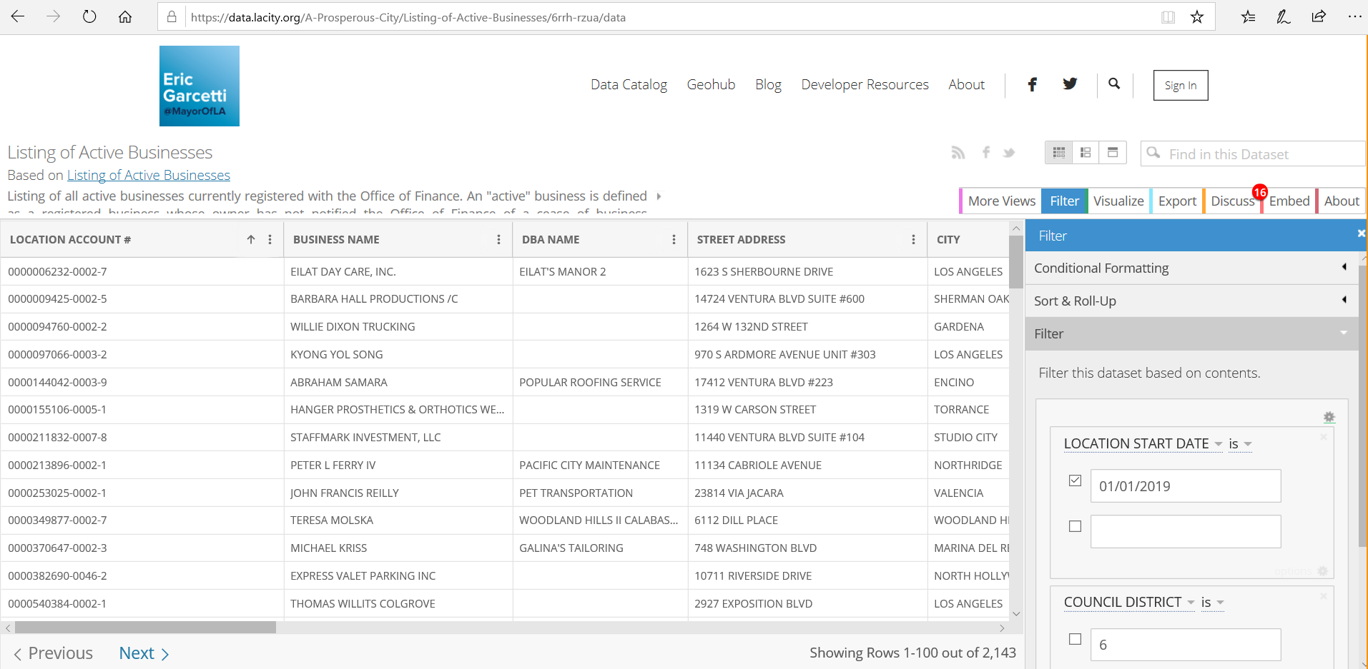
Create a simple SSIS package: Use case
Use case – load data into the database for fast querying
Download an open dataset from LA City
https://data.lacity.org/A-Prosperous-City/Listing-of-Active-Businesses/6rrh-rzua
ETL from a file into a table
Source C:\SSIS-Melissa-COZYROC\Total_Active_Businesses_in_City_of_Los_Angeles_Council_District_06.csv
1KB CSV file with 3 rows and 16 columns (filters = district 6 & location start date 01/01/2019)
Destination Table on a local instance of SQL Server
43 |

Slide 44
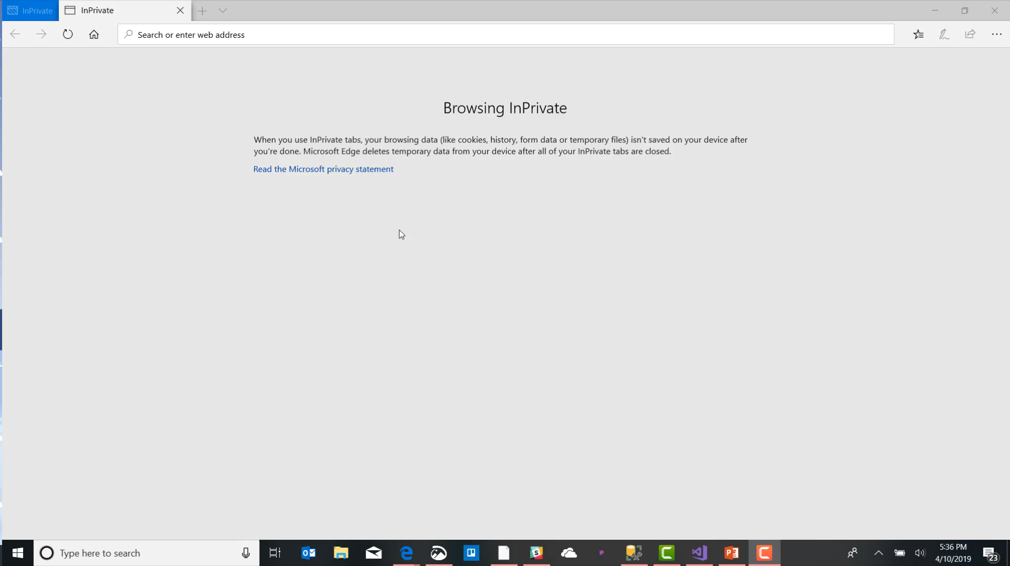
Create a simple SSIS package:
Recorded Demo (made by Camtasia)

Slide 45
Agenda (progress)
Introduction to ETL
Introduction to SSIS
Create a simple SSIS package
What’s new in SSIS 2017
SSIS Third-party components
Test-drive Melissa and COZYROC
45 |

Slide 46
What’s new in SSIS 2017?
Deprecated features
New Features
Still Missing Features
46 |

Slide 47
What’s new in SSIS 2017
Deprecated features
No more VB Script
No more Execute DTS Task
Data Transformation Services (DTS) is deprecated.
47 |

Slide 48
What’s new in SSIS 2017 -
New Features
Unification of SSDT and BIDS into VS 2015
Balanced Data Distributor (BDD)
Package parts
JSON and OData (Open Data Protocol)
BigData, Hadoop File System/Hive/Pig
Enhancements to MDS
SSIS Scale Out/Load Balancing (2017)
48 |

Slide 49
What’s new in SSIS 2017 -
Still Missing Features
sFTP
XML Source and Destination
PGP
Support for Expressions in SQL Parameters
Encryption and masking
REST API
And many more …
49 |

Slide 50
Agenda (progress)
Introduction to ETL
Introduction to SSIS
Create a simple SSIS package
What’s new in SSIS 2017
SSIS third-party components
Test-drive Melissa and COZYROC
50 |

Slide 51










SSIS third-party components -
Vendors Review
Extract Transform
Load
Documentation and performance
SSIS development

Slide 52
Agenda (progress)
Introduction to ETL
Introduction to SSIS
Create a simple SSIS package
What’s new in SSIS 2017
SSIS third-party components
Test-drive Melissa and COZYROC
52 |

Slide 53
Test-drive Melissa and COZYROC
Melissa and COZYROC
Melissa Test-drive
COZYROC Test-drive
53 |

Slide 54
Test-drive Melissa and COZYROC
Data Quality and Enhancement Transforms for SQL Server Integration Services (SSIS)
Melissa’s Data Quality Components for SSIS is a unique set of global data quality
tools for Microsoft’s integration and ETL (extract-transform-load) solution that
empower users to collect data from any source, clean and enrich it during migration
and integration operations, to gain immediate insight for actionable intelligence.
COZYROC SSIS+ is a comprehensive suite of 200+ advanced components for developing
ETL solutions with Microsoft SQL Server Integration Services.
Our easy-to-use, coding-free library of tasks, components and reusable scripts
can significantly cut your development time and also improve the execution speed of your SSIS packages.

Slide 55
Test-drive Melissa and COZYROC
Melissa and COZYROC
Melissa Test-drive
COZYROC Test-drive
55 |

Slide 56
Test-drive Melissa and COZYROC -
Melissa
Overview
How to get started?
Use case
Demo

Slide 57
Test-drive Melissa and COZYROC -
Melissa: Overview
Data Quality tools for SSIS
Address/Phone/Email
  Validation
  Standardization
  Append missing
  USPS and Canada Post NCOA
Deduplication, Fuzzy Matching
Demographics Append
Business and Property

Slide 58
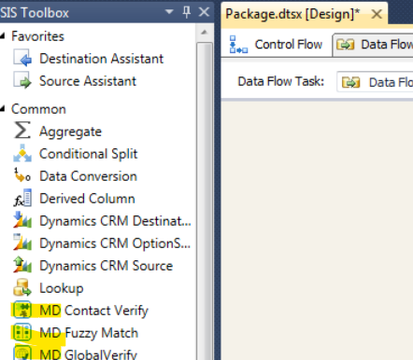
Test-drive Melissa and COZYROC -
Melissa: How to get started
Download
https://www.melissa.com/sql-server
ftp://ftp.Melissa.com/updates/DQC-web.exe
Validate

Slide 59
Test-drive Melissa and COZYROC -
Melissa: Use case
Use case
Extract and validate leads to launch a Direct Marketing campaign for a Shady Insurance Practice
Pull data from Leads table
Validates addresses
Push data into a tsv* file
*tsv = tab separated values

Slide 60
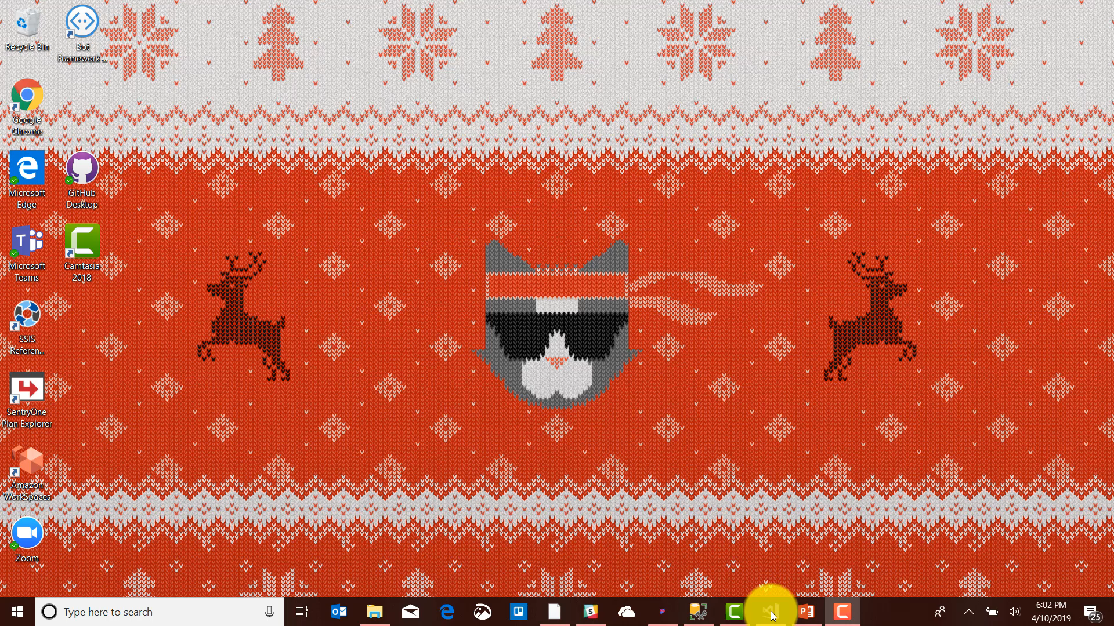
Test-drive Melissa and COZYROC -
Melissa: Recorded Demo (made by Camtasia)

Slide 61
Test-drive Melissa and COZYROC
Melissa and COZYROC
Melissa Test-drive
COZYROC Test-drive
61 |

Slide 62
Test-drive Melissa and COZYROC -
COZYROC: Overview
200+ advanced components for SSIS
Tasks:
  sFTP, SSH, PGP, Zip
  Amazon S3, OneDrive, Dropbox
  JavaScript, Secured SMTP
Components:
  REST API
  SharePoint, EDI, DB2, LDAP, Informix, Oracle
  MongoDB, Google BigQuery
  QuickBooks, Dynamics, SalesForce, ZenDesk, Square

Slide 63
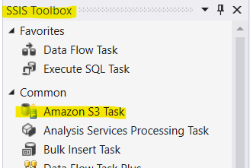
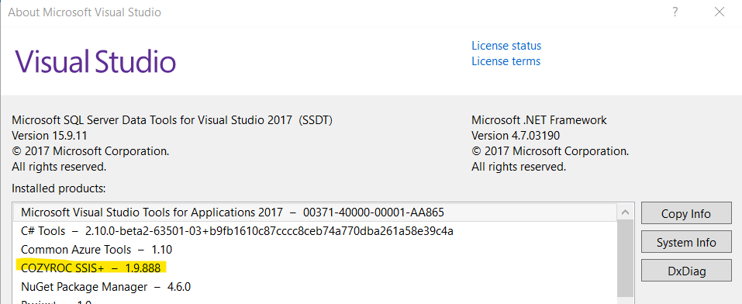
Test-drive Melissa and COZYROC -
COZYROC: How to get started
Download
http://www.cozyroc.com/form/download
http://www.cozyroc.com/ssis/releases
Validate

Slide 64

Test-drive Melissa and COZYROC -
COZYROC: Use case
Use case
Use leads to launch an Email Marketing Campaign for a Shady Insurance Practice
Create a MailChimp account (FREE under 2K subs)
Create an API Key
Create Audience (List) and capture ID
Pull data from Leads table
Transform business name into email
  Email = "info@" + TRIM(REPLACE([BUSINESS NAME]," ","")) + ".com“
  Status = "subscribed"
Create Token File
  server=https://us20.api.mailchimp.com/3.0
Create List Member
  list_id=9687af6d05

Slide 65
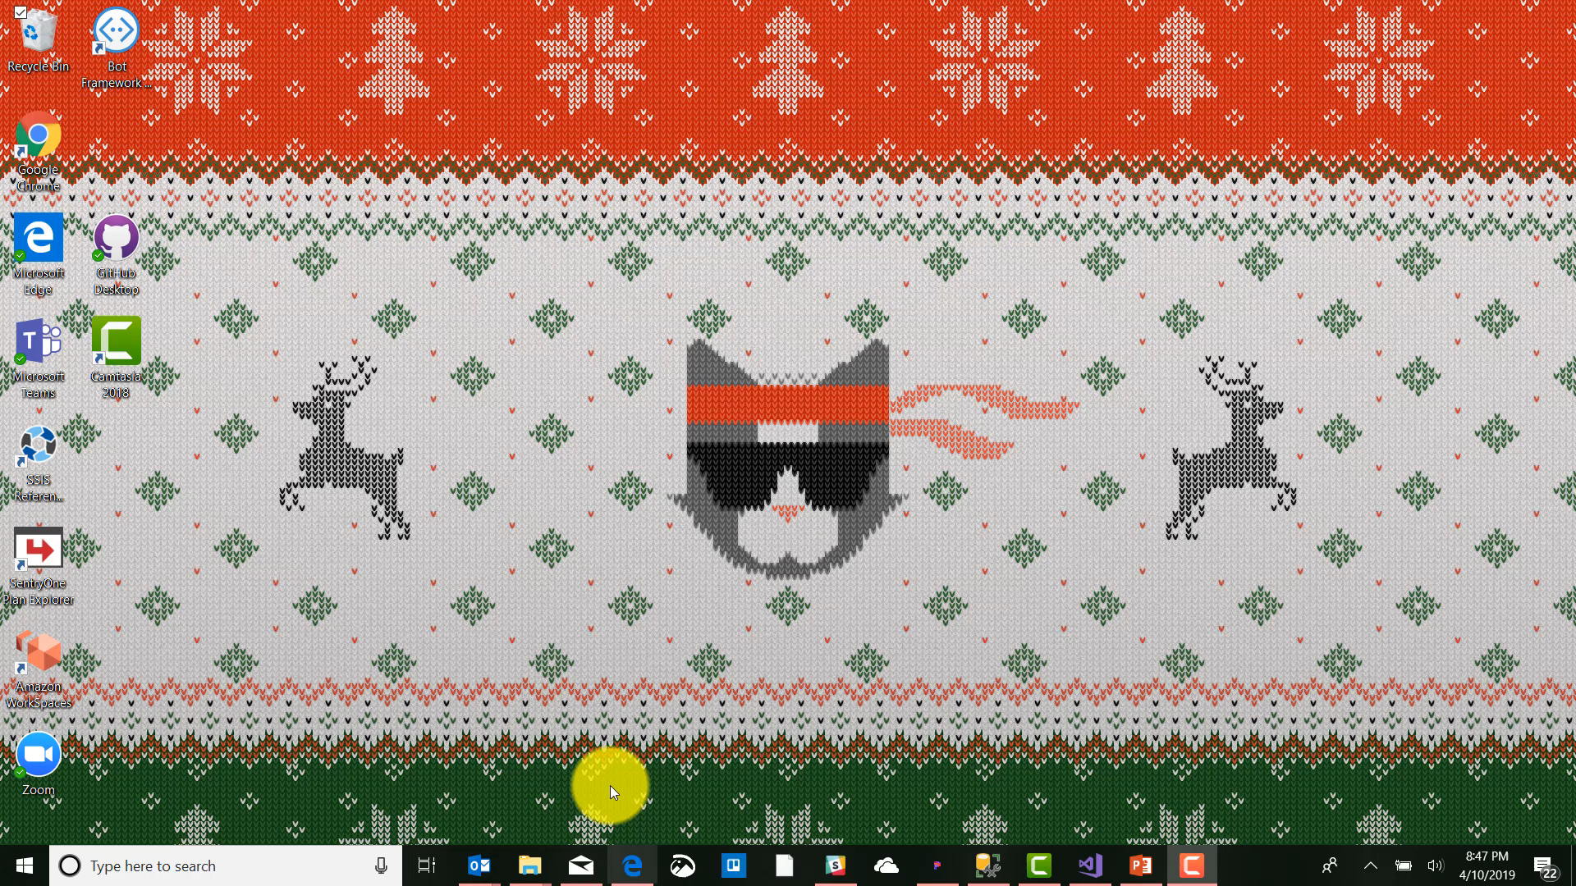
Test-drive Melissa and COZYROC -
COZYROC: Recorded Demo (made by Camtasia)

Slide 66
Test-drive third-party components
COZYROC
Overview
How to get started?
Use case
Demo

Slide 67
Test-drive third-party components
Melissa and COZYROC

Slide 68
Agenda (progress)
Introduction to ETL
Introduction to SSIS
Create a simple SSIS package
What’s new in SSIS 2017
SSIS third-party components
Test-drive Melissa and COZYROC
68 |

Slide 69
Summary
At the end of this session, you should have learned:
ETL
SSIS
Create SSIS package
SSIS 2017
Third-party components
Melissa and COZYROC
69 |

Slide 70




Questions?
Don’t know where to start? Just Bing/Google it!
Thank you!
 | https://www.datasteve.com
 | @SteveRezhener
 | https://www.linkedin.com/in/steverezhener
 | steve.rezhener@hotmail.com
70 |

